Slide 1
iLoo Embracing humanitarian engineering, iLoo is a solar powered internet connected outdoor toilet for rural habitats. A senior design project with the School of Engineering at the University of Connecticut. Materials and construction.

Slide 2
What is iLoo?
‘Loo’ is a room that contains a toilet. iLoo, short for ‘internet loo’, is a pre-fabricated outdoor toilet with solar powered electronics for charging small devices in rural Africa, Asia, and India and connecting to cell towers or internet via StarLink. The innovative design separates solids and liquids waste for easy disposal. The interior toilet box can be either a ‘squat’ or ‘sit’ configuration. A rubber sanitary platform collects cleansing water or spillage in the squat configuration and re-directs it into the solid waste tank. A liquid overflow drum is located outside to minimize ammonia odor generated when feces and urine mix. A flexible hose connects the two tanks. Pre-fab base and roof serve as shipping pallets. Innovative interface between walls and posts enable field level adjustment. The readily available materials can be re-purposed at end-of-life. All electronics are protected in a rugged suitcase inside and connected to the roof mounted 100W solar panel. Expected service life is 1 - 5 years. Target retail materials / electronics cost for a basic model is $800. Interfaces for additional capabilities are considered in the design.

Slide 3
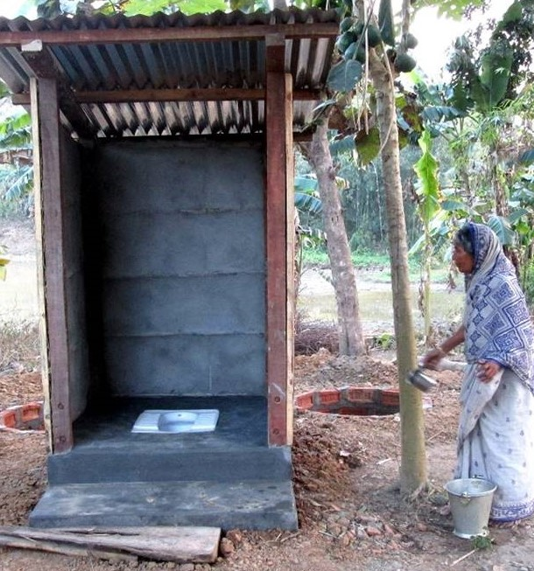
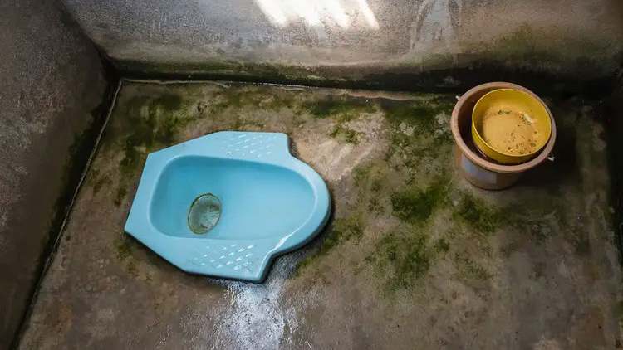
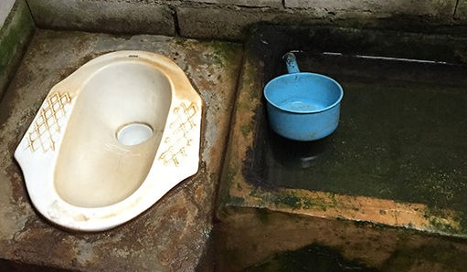
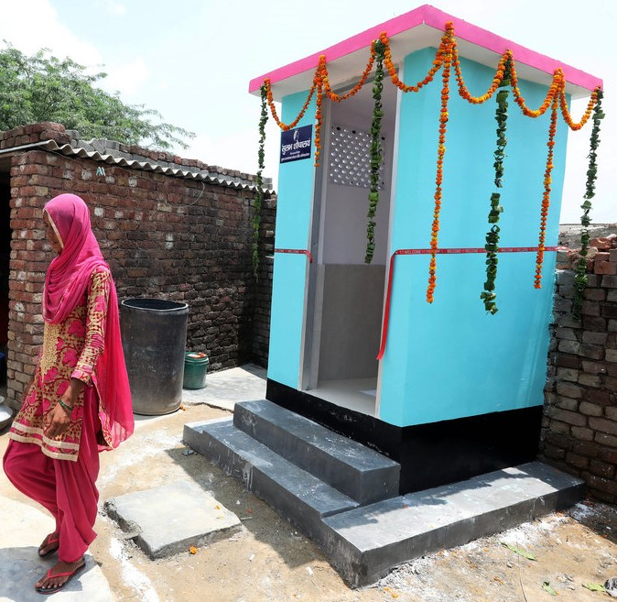
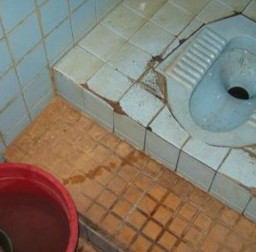
What other toilets look like.

Slide 4
Three Teams at UCONN are working on this senior design project in: 1. Electrical and Computer Engineering (Team ECE4901) design and implement devices, circuits, and systems for communication, computing, power, control, medical diagnostics, and transportation. 2. Management & Engineering for Manufacturing (Team MEM #10) combines mechanical, electrical, civil, and material science engineering as well as business courses including marketing, finance, project management, and accounting. 3. Civil Engineering (Team ENEV9) focuses on structural, geotechnical, construction, and transportation. Environmental Engineering focuses on areas including water quality, green energy, air quality, and contaminated site remediation.
UCONN Engineering Teams and Personnel
Electronics and Computer Engineering (ECE)
Rudy Zhang, team lead
Tyler Rourke
Austin Caracciolo
Management and Engineering for Manufacturing (MEM)
Logan Miller, team lead
Curtis Fetteroll
Randall Louie
Ahmed El-Mouwfi
Civil and Environmental Engineering (CEE)
Zachary Lepore, team lead
Victoria Masucci
Alexa Wetmore
Stephanie Burns
Faculty Advisors (3)
Liang Zhang (ECE)
Craig Calvert (MEM)
Manish Roy (CEE)
Teaching Assistants (3)

Slide 5
4x4 Basic Structure Description
4-foot x 4-foot exterior structure; 7 feet high.
Can be located / re-located easily.
Solids waste drum inside connected to outside liquids waste drum via flexible hose.
Walls and pallets (roof and base) constructed of oriented strand board (OSB).
Plastic sewer pipes inserted into holes in base and roof serve as load bearing posts.
Wall panels inserted into slots cut in sewer pipe as slip joints.
4-inch gap between top of wall and roof pallet provides 360 ventilation.
Waste cuts from 4x8 sheets used as toilet box and step.
100W solar panel on top of pallet roof.
Electronics mounted in roof pallet and wired to solar panel.
Electronic devices ‘fast charged’ in wall-mounted cloth shoe rack.
Squat using removable rubber sanitary platform (‘sanplat’) insert.
Sit using standard western style toilet seat.

Slide 6
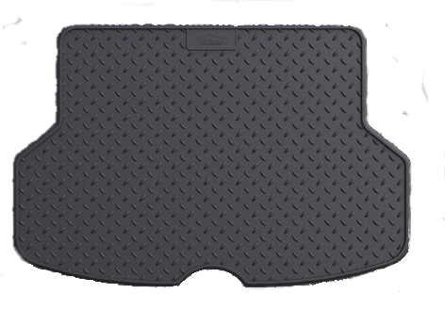
Squat Option
Liquids tank connected by hose to solids tank
30-inch-wide access panel
4-inch plastic sewer pipe posts
Base pallet is 4’x4’x4”.
Roof pallet is 4’x4’x6”.
2x4 pressure treated spacers in base.
2x6 (or 8) PT spacers in roof.
Posts are 84” / 90“ high 4” plastic sewer pipes.
60” slots in posts for wall panels.
Walls are ½“ or 3/8” OSB.
Hinge door for entry and empty solids.
Waste cuts for toilet box and step.
7-inch-wide step.
Rubber boot tray as a ‘sanplat’ to contain cleansing flush.
Toilet box bolted to back panel.
Step bolted to toilet box.
Solid waste hose is a hard connection.
Solid waste drum slides in and out.
Liquid waste drum disconnects.
Rubber cargo liner ‘sanplat’
(41” x 27”)
Pegs hold rubber sanplat (2 places)
Cutout or keyhole
Hinge door panel
48 inches wide
step
Plastic sanplat insert
23-inch-wide x 18-inch-high solid waste drum
Cloth shoe rack for devices
Toilet box
36 inch wide
48 inch wide

Slide 7
Sit Option
Liquids tank connected by hose to solids tank
30-inch-wide access panel
4-inch plastic sewer pipe posts
Base pallet is 4’x7’x 1/2” OSB.
Roof pallet is 4’x7’x3/8” OSB.
2x4 PT spacers in base.
2x2 PT spacers in roof.
Posts are 84“ long x 4” diameter sewer pipes.
70” slots in posts for wall panels.
Walls are ½“ or 3/8” OSB.
Hinge door to remove solid tank.
Waste cuts for toilet seat, step.
9-inch-wide / high step.
Standard toilet seat attached to top of toilet box.
Toilet box bolted to back panel.
Step bolted to toilet box.
Solid waste hose is a hard connection.
Solid waste drum slides in and out.
Liquid waste drum disconnects.
Western toilet seat
Cutout or keyhole
Hinge door panel
48 inches wide
step
23-inch-wide x 18-inch-high solid waste drum
Cloth shoe rack for devices
Toilet box
36 inch wide
48 inch wide

Slide 8
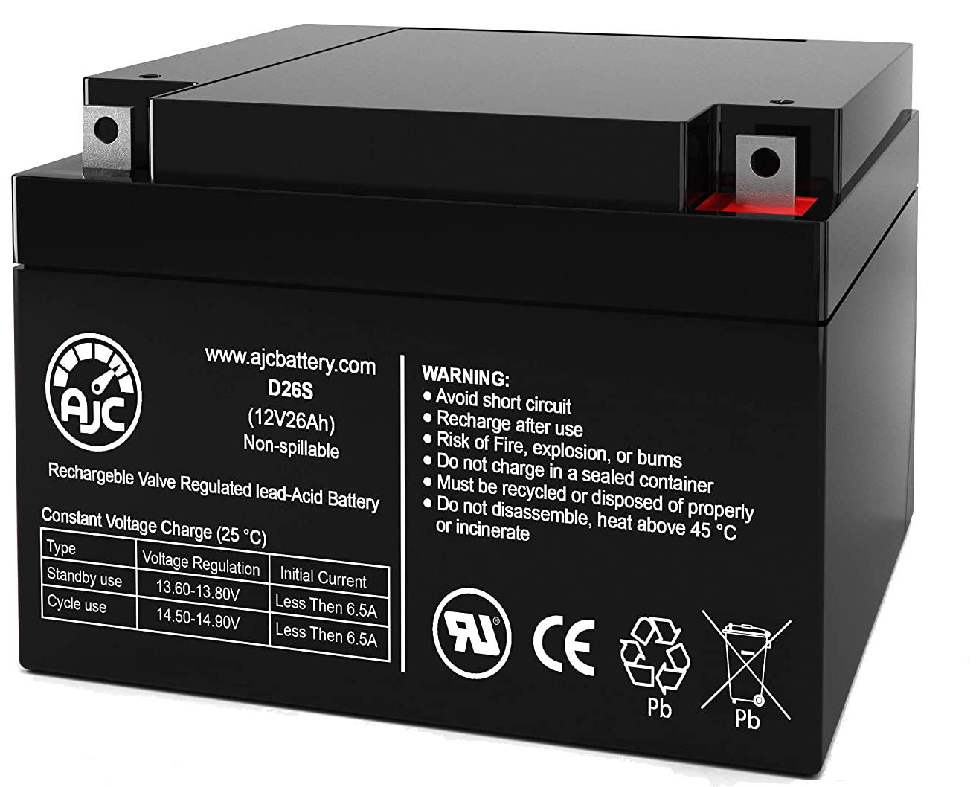
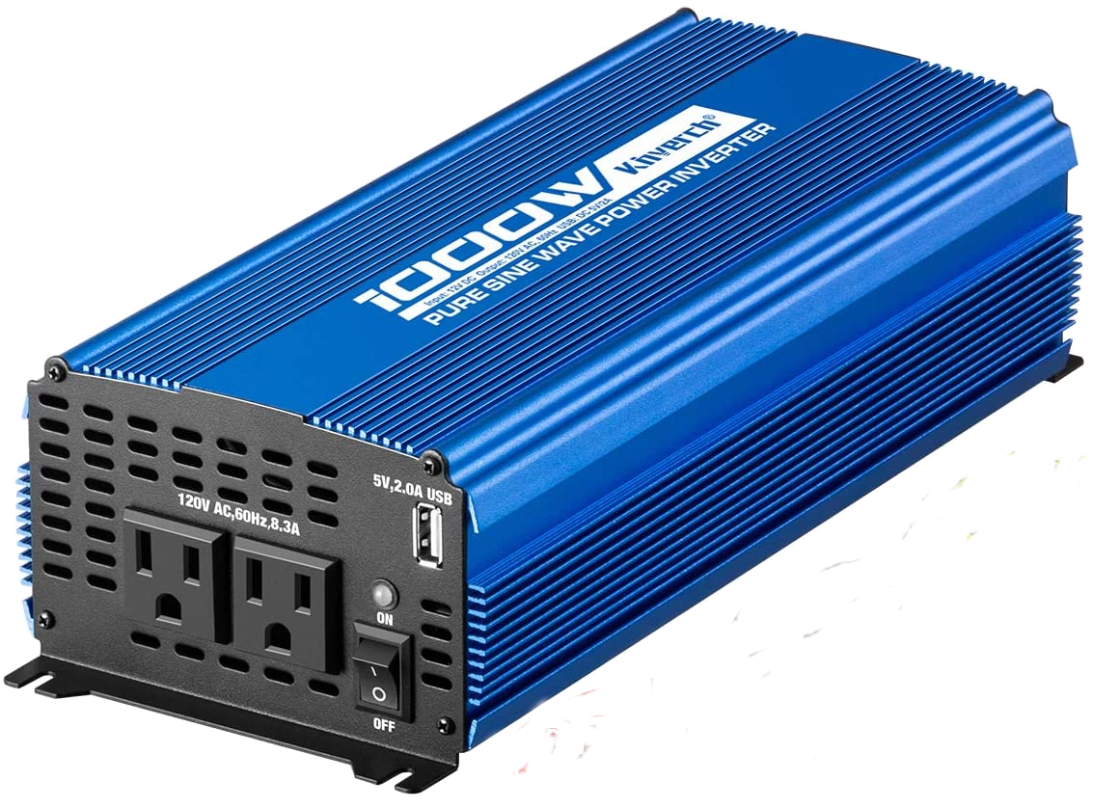
Elevation View
5-degree pitched roof
Electronics mounted in roof pallet
90” long pipe
Pairs of pipes are differential lengths to slope roof pallet.
Tops of pipes are cut on an angle, so pipe sits square on underside of roof.
Ventilation gaps around entire structure.
Electronics mounted in roof pallet for battery ventilation.
Rubber boot tray captures cleansing water and flows into drum.
Interior handrail and light for safety.
84” long pipe
D
D
No-insect light
OSB wall panel
Ventilation gap
Handrail
84 inches high
Toilet box
Door panel with hinged door
23-inch-wide x 18-inch-high solid waste drum
step
48 inch wide

Slide 9
Full scale mockup of iLoo base pallet corner
Top panel is ½ inch OSB.
Bottom panel is ½ inch OSB.
2-inch x 4-inch spacer pressure treated lumber cut.
Each panel 4 feet x 7 feet.
4-inch diameter post hole cut with 4-inch hole saw.
Hole offset 2” from spacer.
Panels and lumber pre-assembled.

Slide 10
Sewer pipe post inserted into base pallet hole
4-inch diameter sewer pipe inserted into base pallet.
Pipe sits on bottom OSB sheet.
½ or 3/8-inch-wide slot routed 4-inches from base up 72 inches.
Allows for 3-inch-high vent gap around entire structure.
Option to apply silicone bead around pipe / sheet interface.
Bead of silicone adhesive here

Slide 11
Wall panel slips into post pipe slot
Self tapping screws here
33-inch (?) wide x 72-inch (?) high OSB panel cut and inserted into slot.
Corner posts will have second slot routed 90 degrees off.
Middle post will have 2 slots 180 degrees apart.
May apply bead of silicone adhesive at base and sewer pipe interfaces.
May drill and insert self-tapping screws into plastic pipe through to OSB.
Bead of silicone adhesive here

Slide 12
Roof Pallet – Assembled Corner
Roof pallet constructed of 2x2 pressure treated lumber and 3/8-inch OSB 4 x 8 sheet.
6 4-inch-diameter holes drilled in bottom sheet of roof pallet.
Roof pallet dropped onto 6 sewer pipe posts.
Gap between top of wall panel and bottom of roof panel is 4-inch-high ventilation around complete structure.
May apply bead of silicone adhesive.
May drill and insert self-tapping screws in plastic pipe through to OSB.

Slide 13
Side view of Assembled Corner
Wall panels slide back and forth to allow adjustable installation and removal.
Sewer pipe diameter allows for up to 2-inch insertion overlap between wall panels.
Pairs of pipes different heights to slope roof. (?)
Sequence of assembly critical.

Slide 14
Top view of pipe and wall panel
Plan view of pipe interior with wall panel shows flexibility and adjustability in assembly.
Wall panel slides back and forth as needed.
4-inch diameter pipe allows for 2-inches of wall panel adjustment.
Sewer pipe repurposed as drainage pipe at end of life.

Slide 15
Manufacturing and Estimated Material Cost
Pre-fabricated or shipping units
Retail Material Cost Estimates
Hinged door and frame
Base pallet
Roof pallet
Solar panel
Wood toilet box
Wood step
Pre-cut plastic sewer pipes (6)
‘SanPlat’ or toilet seat
Cloth shoe rack
Silicone adhesive
Wiring harnesses
10’ sewer pipe @$9 each = $54
6 4’x8’ OSB sheets @$25 each = $150
Cloth shoe rack = $12
‘Sanplat’ or toilet seat = $25
Plastic 55-gallon drum = $45
Miscellaneous hardware and lumber = $50
Total material estimate = $336*
* does not include electronics estimated at $400

Slide 16
Challenges
Design a Sanitary Platform
Capture splash water during cleansing and direct to solids drum.
Provide Lighting
Interior and exterior.
Color discourages insects.
Protect Electronics
Design for heat dissipation, wiring integrity, and safety.
Design a Leak-proof Liquid Transfer between drums
Design a hard connection to solid tank; soft connection to pipe and liquid tank

Slide 17
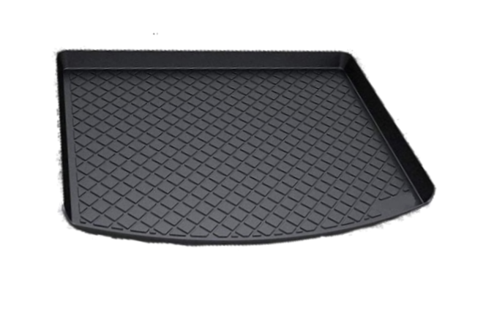
Sanitary Platform
Capture splash from anal cleansing.
Drain into solids tank.
Use modified commercial materials.
Design raised foot pads for placing feet.

Slide 18
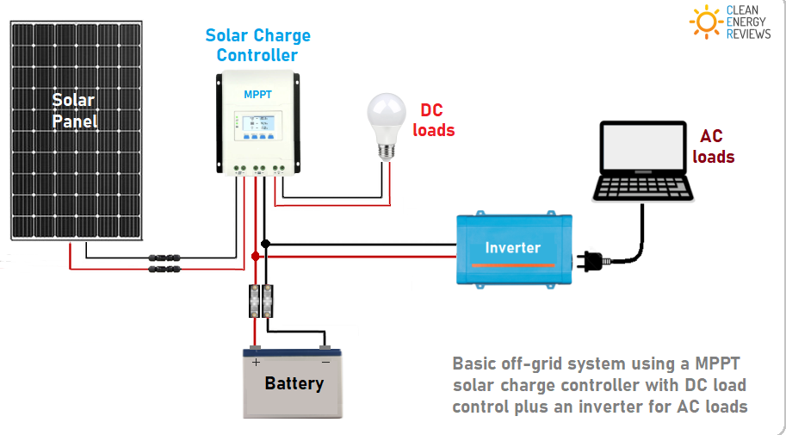
Lighting Interior and Exterior
Lighting extremely important for people to feel safe.
Select light frequency that does not attract bugs.
Light frequency must be culturally sensitive.
Light must put light where it is needed to perform a function.
Attract attention.
Attract focus on tasks.
Light on indicates battery power status.

Slide 19
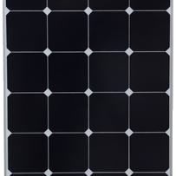
Electronics
Locate electronics in roof pallet.
Protected from environments.
Discourages vandalism.
Considers outgassing and heat dissipation.
Caution on battery – “Do not charge in sealed container”.
Battery dimensions and weight a driving factor.

Slide 20
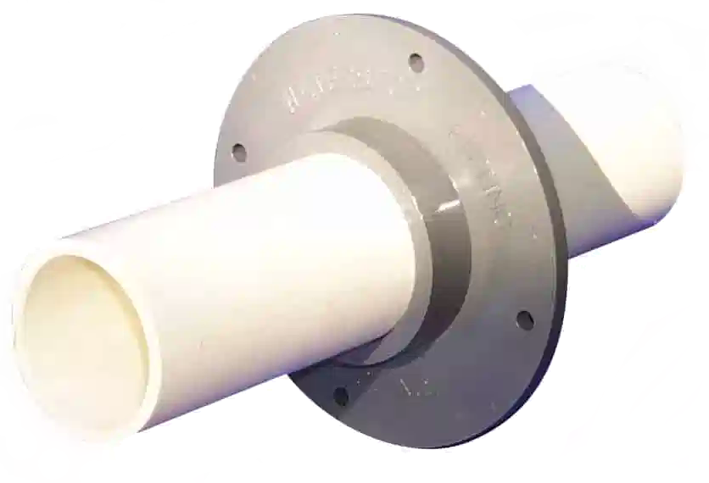
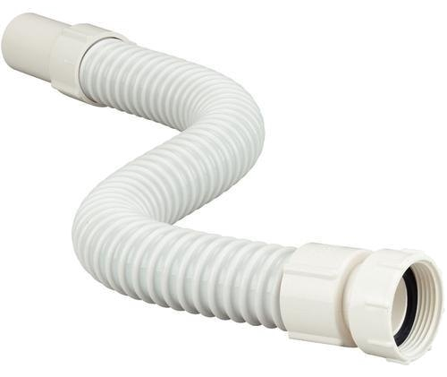
Leak-proof Waste Transfer
No leak waterstop flange
Flexible waste pipe
Solid waste drum
Hard connection to solid drum.
Soft connection to liquid drum.
Intermediate disconnect.
May need a Filter.
Cost about $15
Liquid waste drum

